Slide 1

Course Instructor- Dr. Sivasankar P. Presented by- Manish Kumar
EOR Screening using Classification and Clustering
Enhanced Oil Recovery
Dept. of Petroleum Engineering
Indian Institute of Petroleum and Energy
Visakhapatnam-530003

Slide 2
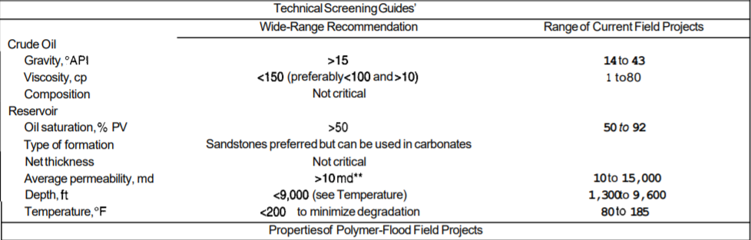
Introduction
Initial step of EOR selection
Conventionally go/no/go approach was used
Used range of Reservoir & fluid parameters to filter EOR methods
ML can find hidden patterns
Fig 1. Selection Criteria for Polymer flooding Taber et al. in 1997

Slide 3
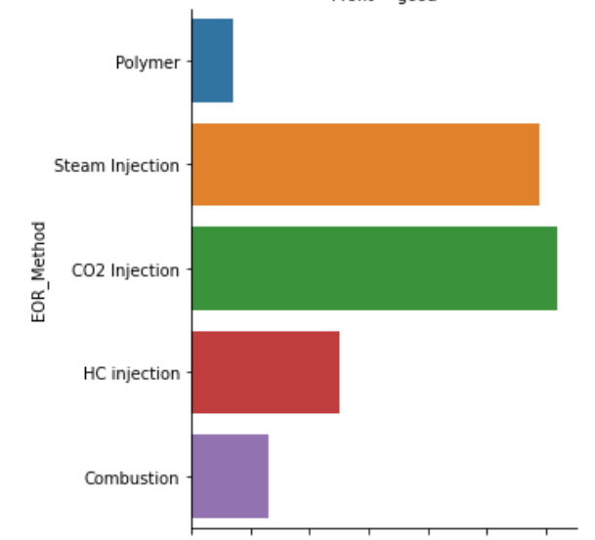
Data Preparation and Analysis
Establishing a dataset is a challenge
Dataset with 203 samples
Various Pre processing steps
CO2 and Steam injection most widely implemented
Fig 2. Common EOR methods

Slide 4
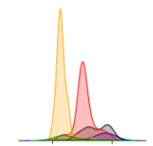
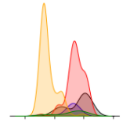
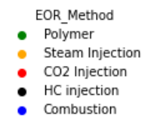
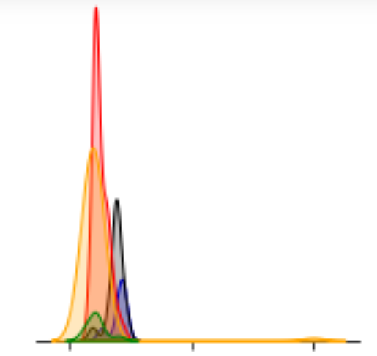
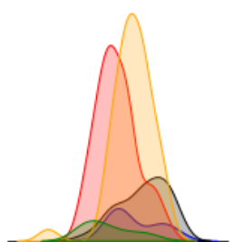
Some Visible Trends
Oil Saturation HC>Steam>CO2 injection>Combustion>Polymer
Temperature Combustion>HC Injection>CO2 injection>Polymer>Steam
Gravity HC injection->CO2 Injection->Polymer->Combustion->Steam Injection
Depth HC injection->Combustion->CO2 Injection->Polymer->Steam Injection
Depth
Gravity
Temperature
Oil Saturation
Fig 3. Probability density plots of EOR’s v/s Reservoir Properties indicating trends in data

Slide 5
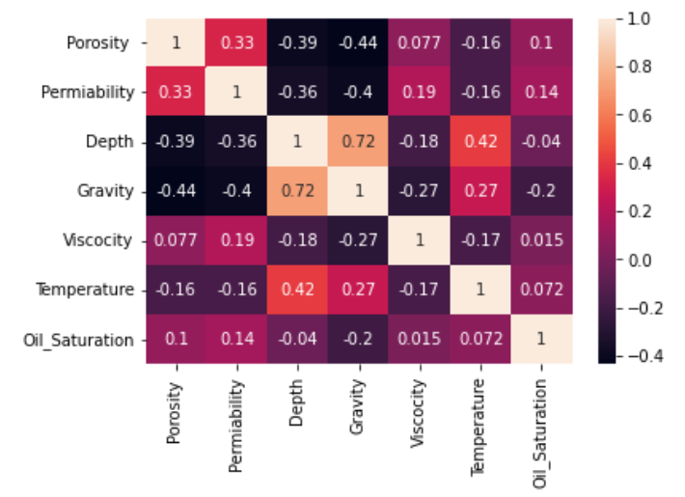
Correlation between various features
Fig 4. Person correlation between features

Slide 6
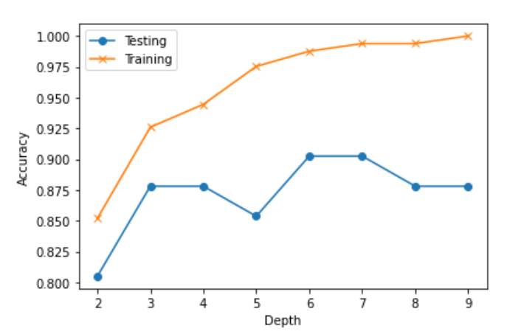
Splitting data and Training
20 % of dataset was used as test data
Split was stratified to ensure uniform proportional splitting
Random Forest Classifier was used to train the data
Training accuracy of 98.76% and testing accuracy of 90.24%
Fig 5. Accuracy vs Max depth of Random Forest Classifier

Slide 7
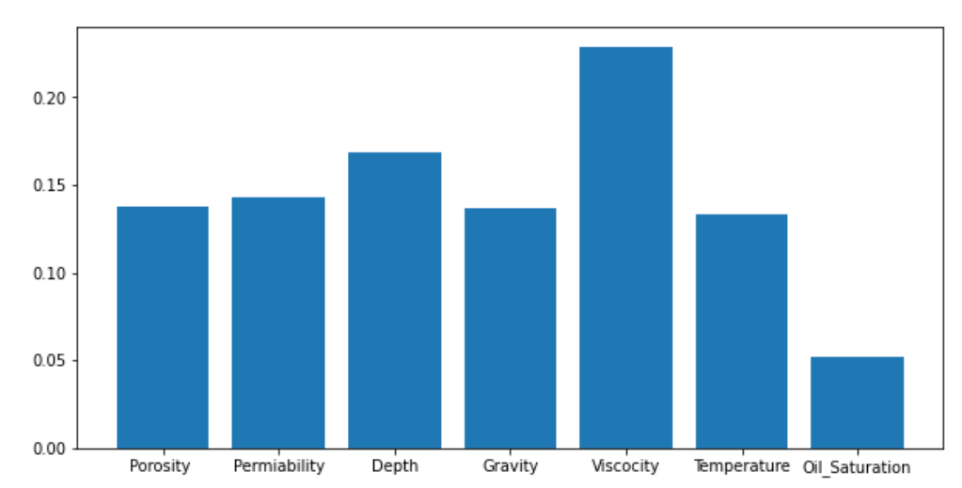
Feature Importance
Fig 6. Feature importance obtained from Random Forest Classifier

Slide 8
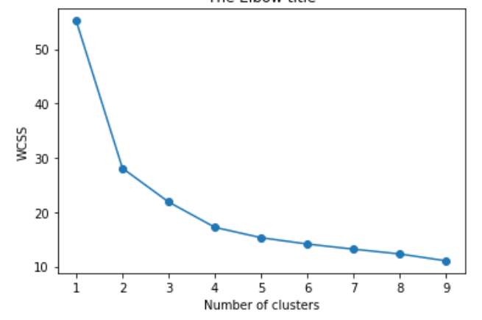
Analysing through clustering
Data is scaled by Min Max Scaler
KMeans algorithm was used
Numbers of clusters were 5
Generated Similar results
Fig 7. Plot of Inertia v/s number of clusters to determine number of clusters

Slide 9
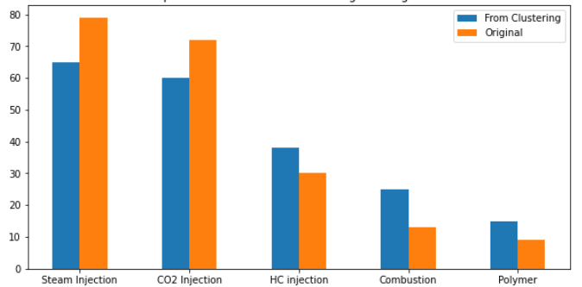
Comparison of result from Clustering and original data
Fig 8. Count plots of results obtained from KNN clustering and original data

Slide 10
References
Taber, J.J., Martin, F.D., and R.S. Seright. "EOR Screening Criteria Revisited—Part 2: Applications and Impact of Oil Prices." SPE Res Eng 12 (1997): 199–206. doi: https://doi.org/10.2118/39234-PA
Development of a hybrid scoring system for EOR screening by combining conventional screening guidelines and random forest algorithm https://doi.org/10.1016/j.fuel.2019.115915

Slide 11
Thank You

